Slide 1


Migrating to DPC++
1

Slide 2
Outline
Introduction
What is Data-Parallel Programming
What are Heterogeneous Systems
Platform Model
Where Code Executes
Choosing a device on which to execute
Queues
Execution Model
Device dispatch and memory copy mechanisms
Data management
Buffers
Ordering the Uses of Data
Expressing Parallelism
Parallelism within Kernels
Basic Data Parallel Kernels
ND-Range Kernels
Hierarchical Data Parallel Kernels
Choosing a kernel form
2

Slide 3
Introduction
What is Data-Parallel Programming
What are Heterogeneous Systems
Platform Model

Slide 4
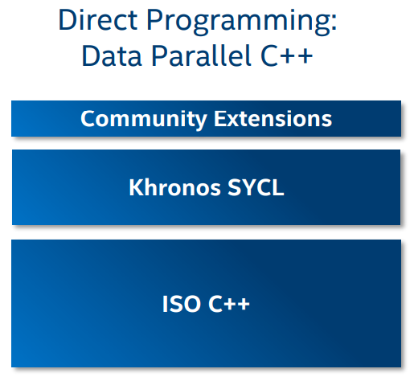
Data Parallel C++ (DPC++)
Data Parallel C++
A high-level language designed for data parallel programming productivity
An extension of C++, incorporating SYCL and other new features.
Notes:
Data Parallel C++ is an extension of C++, incorporating SYCL and other new features. SYCL is an industry led for adding data parallelism to C++ for heterogeneous systems. To avoid saying “SYCL and DPC++” over and over, consider these: we speak of DPC++ in an inclusive manner, and all SYCL features are always DPC++ features as well.

Slide 5
What is Data-Parallel Programming?
Approach for parallel programming:
Data parallel
Data is operated on in parallel by a collection of processing elements.
Each processing element is hardware capable of some computation on the data.
Processing elements may exist on a single device, or many devices in computer systems.
Specify code to work on data in the form of a kernel.
What operations (written as a kernel) should apply to every data element.
Best on regular data structures like arrays and matrices.
Task parallel
Specify a distribution of code among processing elements
Work to have the data travel to the computations as dictated by the code.
The features of DPC++ supports both parallel programming styles.
You can use elements of both data-parallel and task-parallel programming
Notes:
There are two approach for parallel programming: Task-parallel and Data parallel.
In Data-parallel programming, Data is operated on in parallel by a collection of processing elements. Each processing element is hardware capable of some computation on the data. We specify our code to work on our data in the form of a kernel. Therefore, we should focus on specifying what operations (written as a kernel) should apply to every data element. Data-parallelism applies best on regular data structures like arrays and matrices.
When we are programming in a task-parallel fashion, we specify a distribution of code among processing elements and then work to have the data travel to the computations as dictated by the code. As a Parallel programmer, you should use elements of both data-parallel and task-parallel programming. Therefore, the features of DPC++ supports both parallel programming styles.

Slide 6
What are Heterogeneous Systems?
Any system which contains multiple types of computational devices.
CPU (Central Processing Unit, often simply called a processor)
For general purpose code including scalar and decision making (frequently branching) code, and often have built in accelerators for vectors.
GPU (Graphics Processing Unit)
Accelerate vectors, and the closely related tensors
FPGAs (Field Programmable Gate Arrays)
Suited to accelerate spatial problems, including problems expressed in terms of flow graphs or pipelines.
ASICs (Application Specific Integrated Circuits)
Suited to accelerate spatial problems, including problems expressed in terms of flow graphs or pipelines.
DSPs (Digital Signal Processors)
Accelerate specific mathematical operations with low latency
AI chips (graph, neuromorphic, etc.)
Accelerate matrix operations, although some may accelerate graphs as well
Notes:
A heterogenous system is any system which contains multiple types of computational devices. For instance, a system with both a CPU (Central Processing Unit, often simply called a processor) and a GPU (Graphics Processing Unit) is a heterogeneous system.

Slide 7
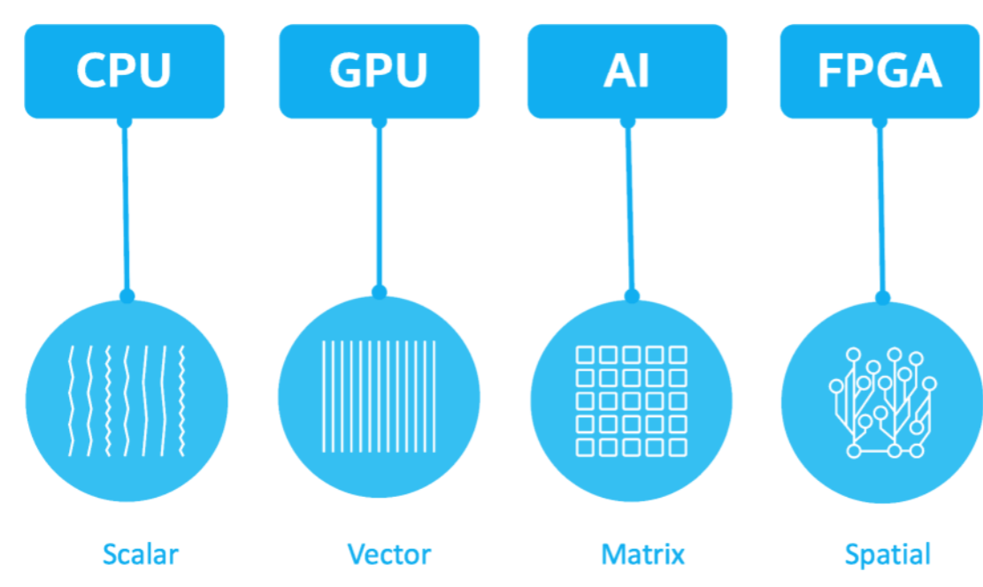
Challenge of Heterogeneous Systems
Multiple types of devices
Different architectures
Different characteristics
Different programming and optimization needs for each device.
This creates a number of challenges
Solve these challenges being the motivation behind DPC++.
Utilizes a taxonomy of Scalar, Vector, Matrix, and Spatial
Notes:
Having multiple types of devices, each with different architectures and therefore different characteristics, leads to different programming and optimization needs for each device. This creates a number of challenges —helping solve these being the motivation behind DPC++.
Accelerator architectures can be bucketed into broad categories that impact how we need to think about the programming model, and the types of workloads that an accelerator will perform well on.
For example, CPUs are the best choice for general purpose code including scalar and decision making (frequently branching) code, and often have built in accelerators for vectors. But FPGAs and ASICs are particularly suited to accelerate spatial problems.

Slide 8
Platform Model
The platform model specifies a host that coordinates and controls the compute work that is performed on the devices.
A device is an accelerator, presumably with specialized capabilities.
There is always a device corresponding to the host (the host device).
The choice of the devices on which to run device code is under program control.
Coding in DPC++ or SYCL has a “single source” property
The host code and device code can exist within the same source file.
Notes:
The platform model, used by DPC++, specifies a host that coordinates and controls the compute work that is performed on the devices.
A device is an accelerator, presumably with specialized capabilities. There is always a device corresponding to the host, known as the host device. Providing this guaranteed-to-be-available target for device code allows device code to be written assuming at least one device is available, even if it is the host itself! The choice of the devices on which to run device code is under program control - it is entirely our choice as programmer if, and how, we want to execute code on specific devices.

Slide 9
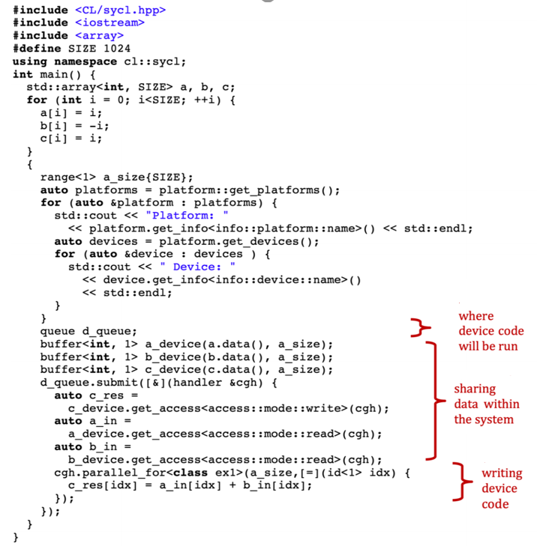
Example
Single source allows host and device code to be easily considered, and also optimized, together by a compiler
Notes:
Coding in DPC++ or SYCL has a “single source” property, which means that host code and device code can exist within the same source file. This is illustrated in this slide:

Slide 10
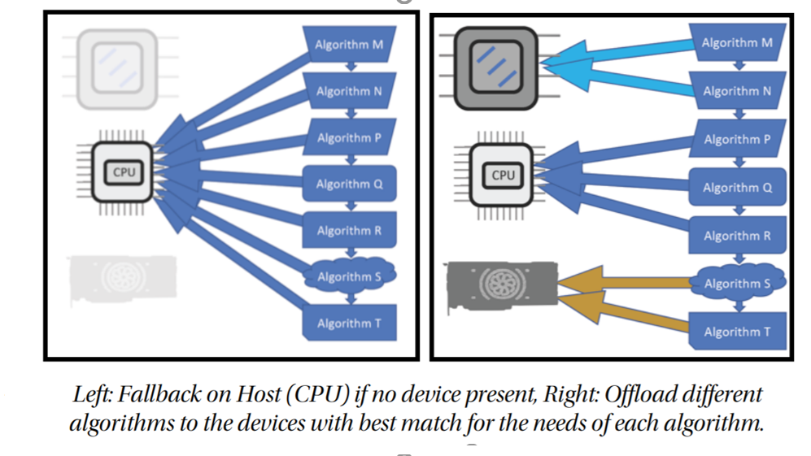
CPU VS CPU+Devices
A single application may use multiple accelerators, but with specific purposes for each.
In Figure : an application may use different algorithms that may be designed to perform on a particular type of accelerator if present.
Notes:
A single application may use multiple accelerators, but with specific purposes for each. In the following Figure, we consider that an application may use different algorithms that may be designed to perform on a particular type of accelerator if present. Such a program can run everywhere, and the CPU is used unless a well-suited accelerator is available for a particular algorithm.

Slide 11
Where Code Executes?
Choosing a device on which to execute
Queues
Execution Model
Device dispatch and memory copy mechanisms
Notes:
Here, we describe where code can execute, introduce when it will execute, and describe the mechanisms used to control the locations of execution.

Slide 12
Where Code Executes?
DPC++ applications
C++ host code which is executed by the CPU(s)
Host code is the backbone of the application in that it defines and controls the execution of compute on available devices.
The host code orchestrates data movement and compute offload to devices, but can also perform compute-intensive work itself.
Devices correspond to accelerators or processors
Conceptually independent from the CPU that is executing host code.
Run device code.
Device code executes asynchronously from the host code, unless the developer explicitly ties the two together.
Notes:
DC++ applications contain C++ host code which is executed by the CPU(s) on which the operating system has launched the application. Host code is the backbone of the application in that it defines and controls the execution of compute on available devices. The host code orchestrates data movement and compute offload to devices, but can also perform compute-intensive work itself.
he host processor runs native C++ code, while devices run device code. Queues are the mechanism through which host code submits work to a device for future execution. Device code executes asynchronously from the host code, unless the developer explicitly ties the two together.

Slide 13
Choosing a device on which to execute
To explore the mechanisms that control where device code executes
Running device code “somewhere”, with the developer not caring which device it ends up being.
Explicitly running device code on the host device, which is typical used for debugging.
Dispatching device code to another accelerator device.
Dispatching device code to a heterogeneous set of devices.
Selecting specific devices from a more general class of devices, such as a specific type of FPGA from a collection of available FPGA devices.
Notes:
To explore the mechanisms that control where device code executes, you can consider the following use cases:
To talk about choice of a device, even one that the implementation has selected for the user, it’s important to first introduce the primary mechanism through which the program interacts with a device: the queue.

Slide 14
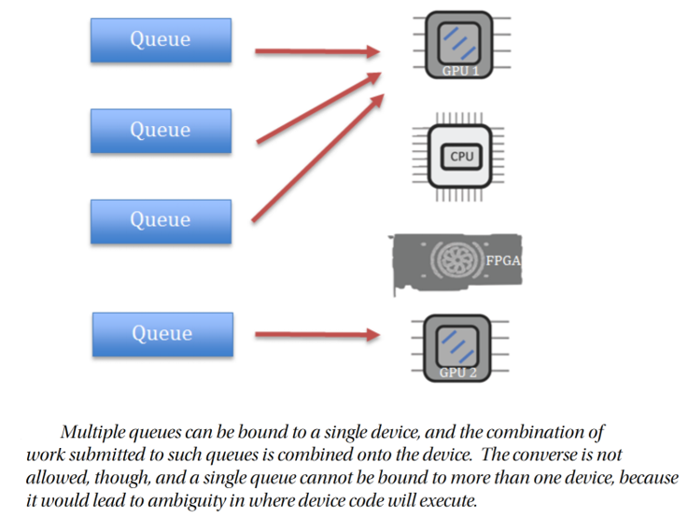
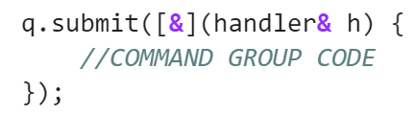
Queue
The mechanism through which host code submits work to a device for future execution.
A sycl::queue is an abstraction to which work is submitted for execution on a single device.
A sycl::queue is bound to a single sycl::device, and that binding occurs on construction of the queue.
Notes:
A queue is an abstraction to which work is submitted for execution on a single device. A queue is bound to a single sycl::device, and that binding occurs on construction of the queue

Slide 15
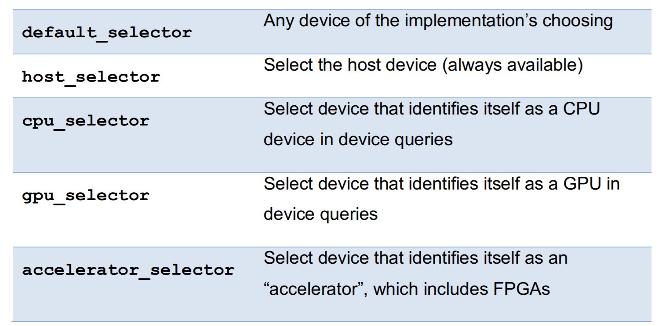
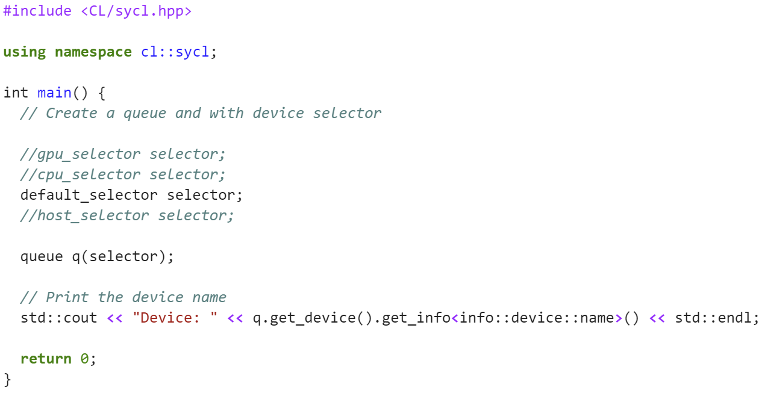
Device Selector Class
Enables the runtime selection of a particular device to execute kernels based upon user-provided heuristics.
Selection of the device is achieved through a device selector abstraction and associated sycl::device_selector class.
One additional selector is shipped as part of DPC++ (not available in SYCL), and is available by including the header “CL/sycl/intel/fpga_extensions.hpp”
Notes:
Selection of the device is achieved through a device selector abstraction and associated device_selector class.
SYCL defines five built-in selectors for the broad classes of common devices a you can see in the table:

Slide 16
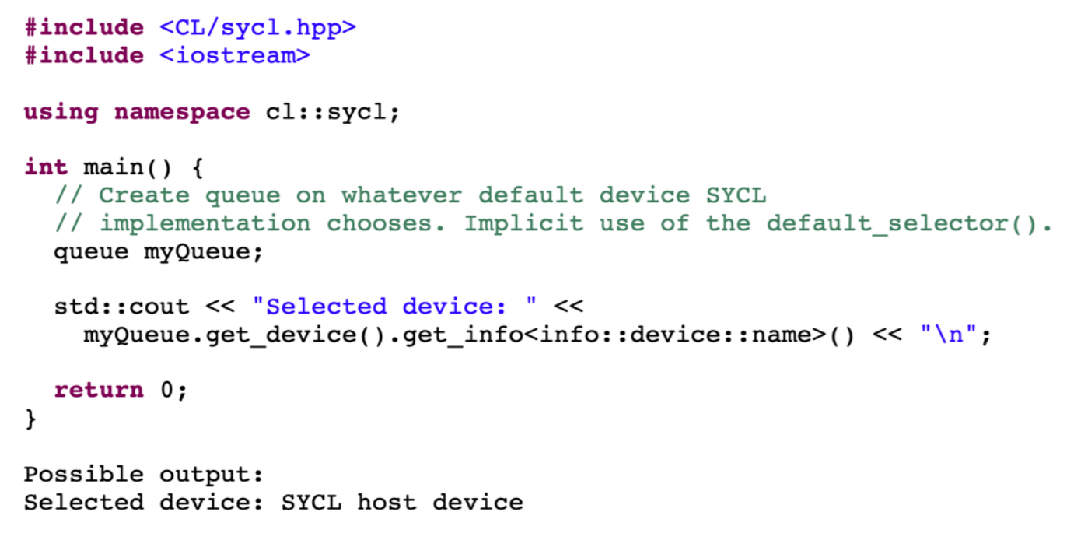
Example Code
Device with which a queue will be bound is not specified.
The trivial queue constructor, that doesn’t take any arguments, simply chooses some available device behind the scenes.
SYCL guarantees that at least some device will be available, which might be the SYCL host device.
Notes:
Following Figure provides an example code listing, where the device with which a queue will be bound is not specified. The trivial queue constructor, that doesn’t take any arguments, simply chooses some available device behind the scenes. SYCL guarantees that at least some device will be available, which might be the SYCL host device.

Slide 17
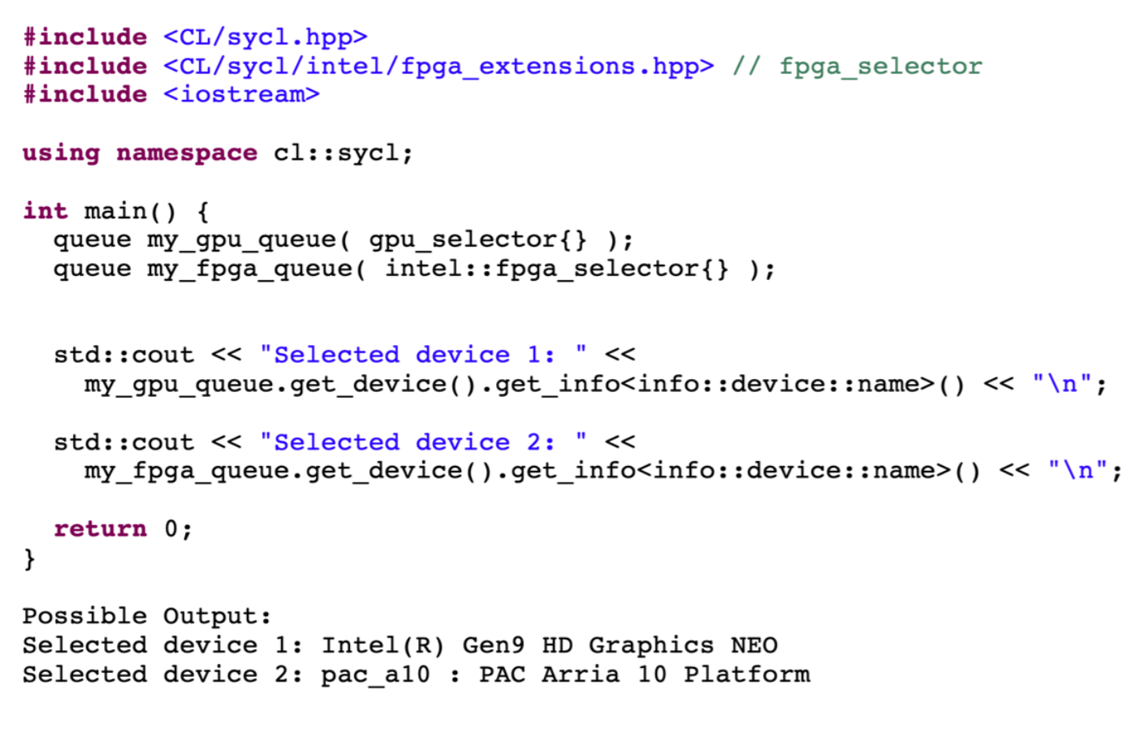
Multiple Queues
Notes:
multiple queues can be constructed in the DPC++ application

Slide 18
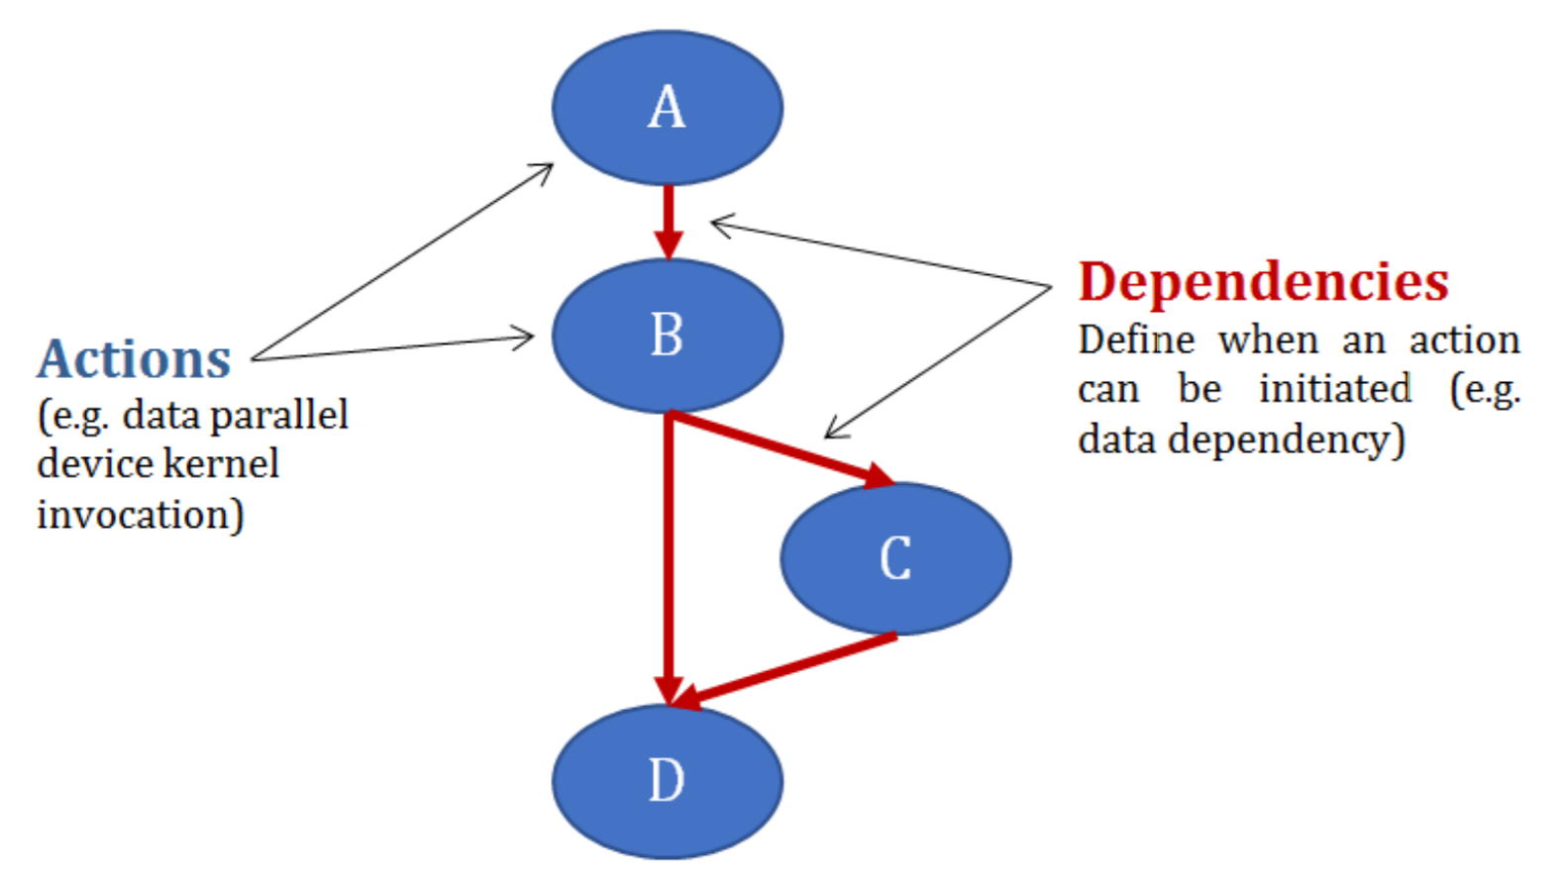
Execution Model
A fundamental concept in the DPC++ execution model is a graph of nodes (Directed Acyclic Graph (DAG)).
Each node in this graph contains an action to be performed on a device.
The nodes have dependency edges defining when it is legal for a node’s work to begin execution.
The dependency edges are most commonly generated automatically from data dependencies.
Notes:
A fundamental concept in the DPC++ execution model is a graph of nodes. Each node in this graph contains an action to be performed on a device. The nodes have dependency edges defining when it is legal for a node’s work to begin execution. The dependency edges are most commonly generated automatically from data dependencies.

Slide 19
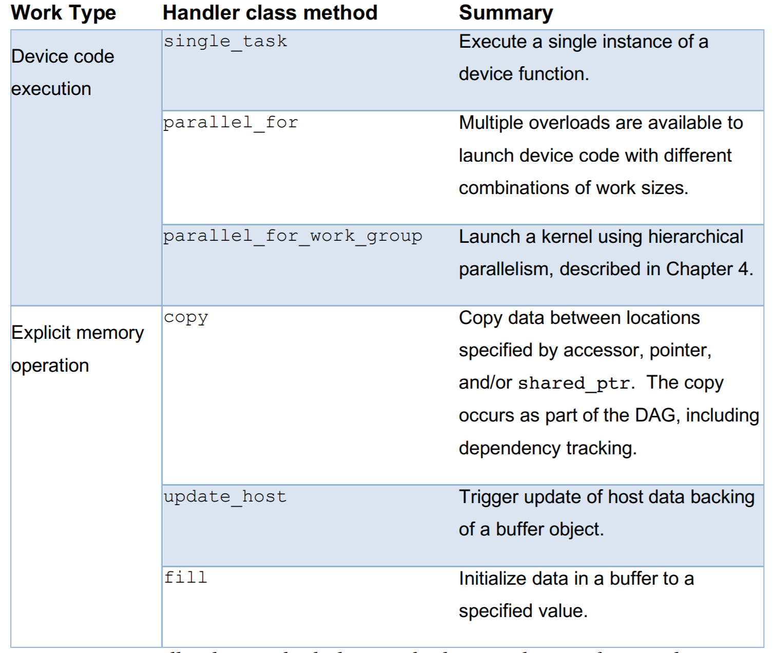
Device dispatch and memory copy mechanisms
A command group can be submitted to a queue
The queue defines the device on which the work is to be performed.
Within the command group, there are two categories of code
At most one call to a handler class method that either dispatches work to be performed on the device (device code forming a kernel), or that performs a manual data movement command such as copy
Host code that typically sets up dependencies defining when it is safe for the SYCL runtime to start execution of the work defined in (1)
Notes:
As we said, DPC++ applications typically contain a combination of both host code and device code. We introduce some of the basic DPC++ work dispatch constructs, with the goal to help you understand and identify the division between device code, and the host code.
a simple example is a lambda function to identify such code:
A command group can be submitted to a queue, and the queue defines the device on which the work is to be performed. Within the command group, there are two categories of code:
At most one call to a handler class method that either dispatches work to be performed on the device (device code forming a kernel), or that performs a manual data movement command such as copy
Host code that typically sets up dependencies defining when it is safe for the SYCL runtime to start execution of the work defined in (1)
Right figure summarizes these methods!

Slide 20
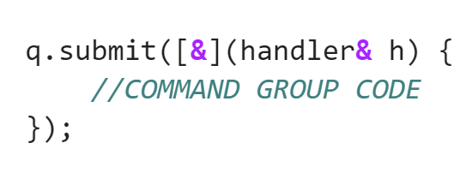
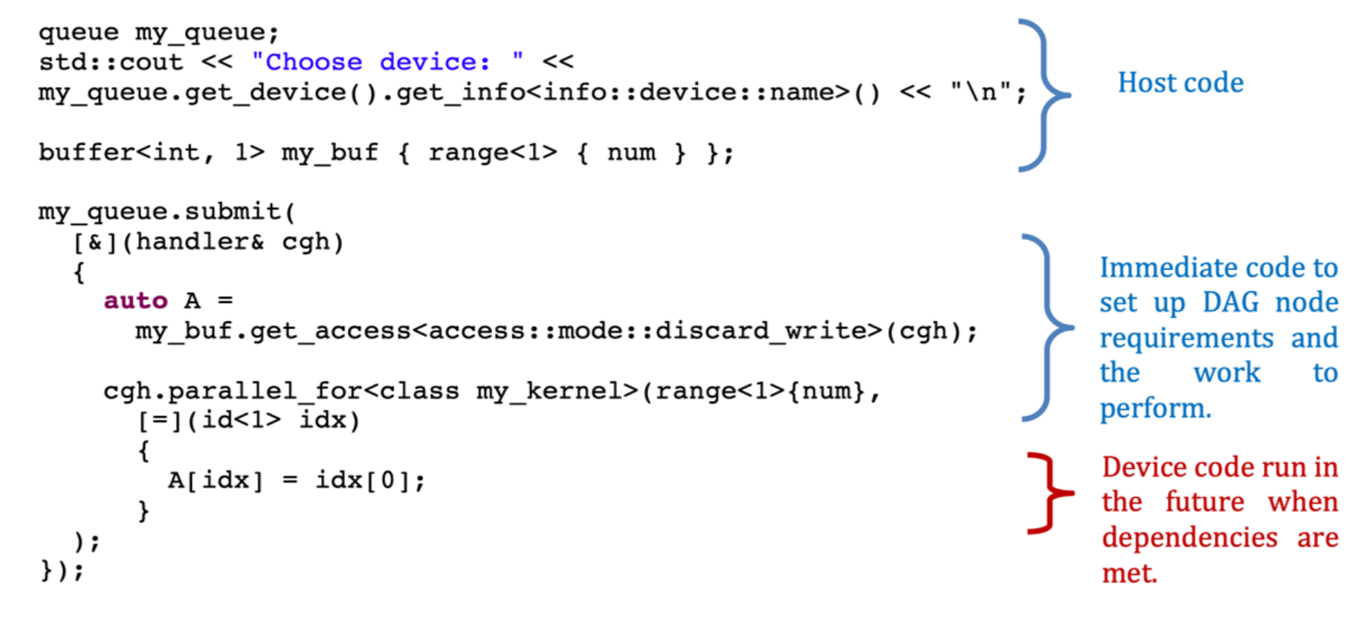
Example
Only a single
handler method may be called within a command group
command group can be submitted to a queue per submit call.
The code passed as the final argument to the parallel_for member of the sycl::handler class, defined as a lambda, is the device code to be executed on a device. The parallel_for in this case is the critical construct that is used to distinguish device code from host code.
Notes:
In the below figure, the code passed as the final argument to the parallel_for member of the handler class, defined as a lambda, is the device code to be executed on a device. The parallel_for in this case is the critical construct that is used to distinguish device code from host code.

Slide 21
Data Management
Buffers
Ordering the Uses of Data

Slide 22
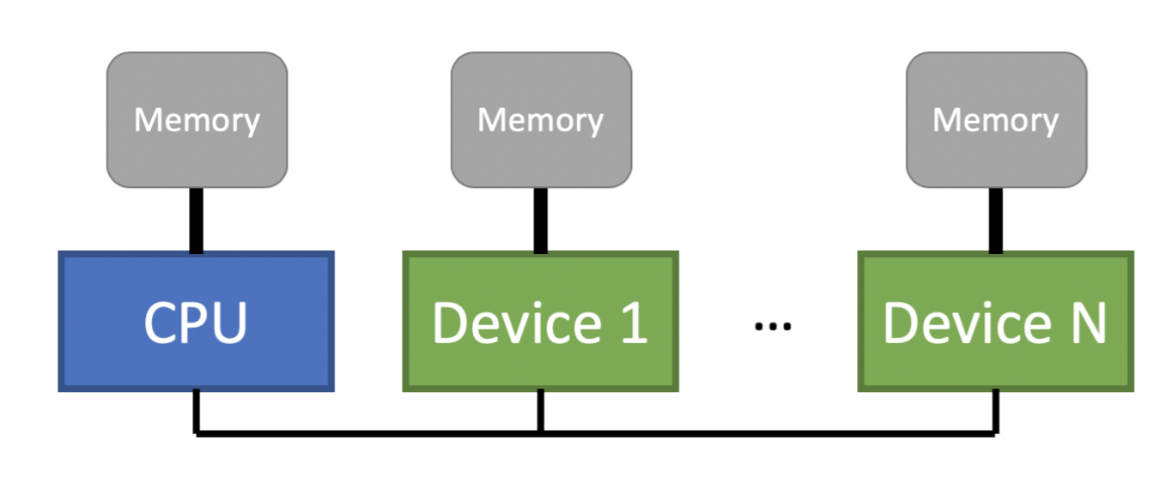
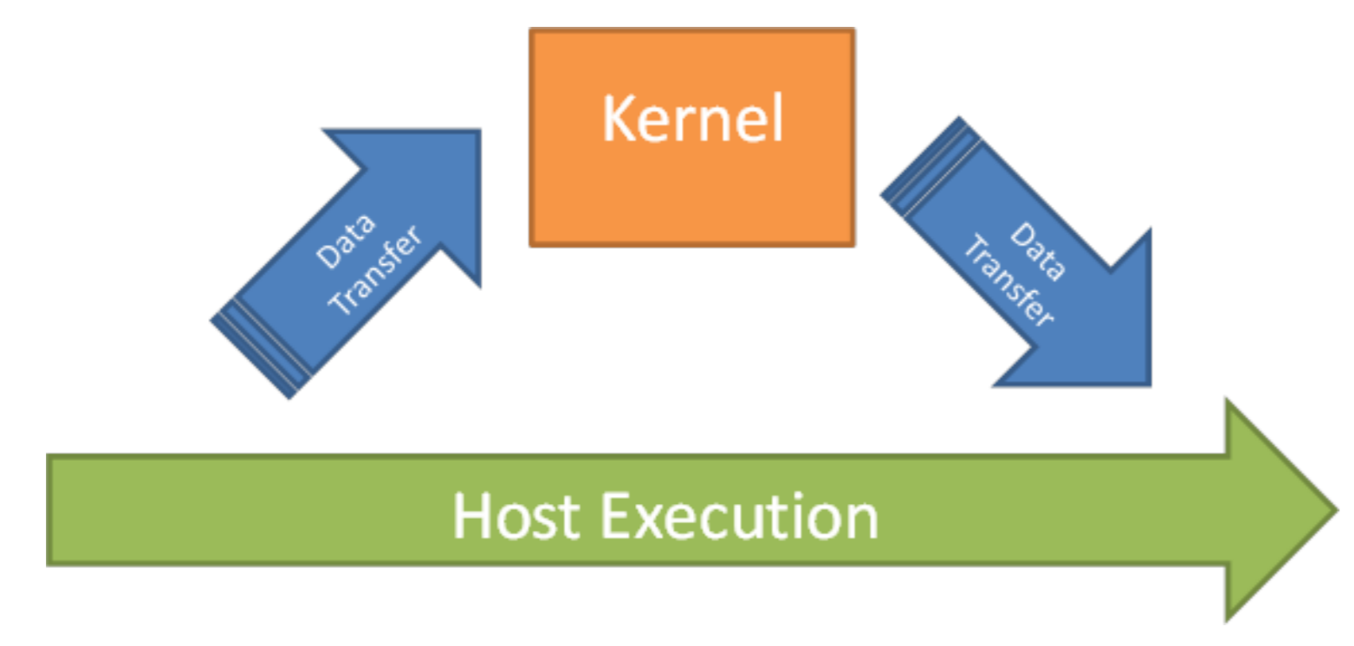
Data Management
One of the most important aspects of data parallel computations is how they access data.
Accelerator devices often have their own attached memories that cannot be directly accessed from the host.
For data management introduce:
Unified Shared Memory
Buffer abstractions
local accesses: accesses to a directly attached memory to an accelerator as
Remote accesses: Accesses to another device’s memory
Notes:
Compute is nothing without data. The whole point of accelerating a computation is to produce an answer more quickly, so one of the most important aspects of data parallel computations is how they access data. Accelerator devices often have their own attached memories that cannot be directly accessed from the host. Hence, we introduce Unified Shared Memory and the Buffer abstractions for data management.
We refer to accesses to a directly attached memory to an accelerator as local accesses. Accesses to another device’s memory are remote accesses. Remote accesses tend to be slower than local accesses.

Slide 23
Managing Multiple Memories
Explicitly by the programmer
After the kernel computes new results, the programmer must also copy these results back to the CPU before the host program can use that data
Implicitly by the runtime
The parallel runtime is responsible for ensuring that data is transferred to the appropriate memory before it is used.
Notes:
Managing multiple memories can be accomplished, broadly, in two ways: explicitly by the programmer or implicitly by the runtime.

Slide 24
Managing Memories in DPC++
Unified Shared Memory (USM)
A pointer-based approach that should be familiar to C/C++ programmers
Buffers
Describe one-, two-, or three-dimensional arrays.
Buffers provide an abstract view of memory that can be accessed on either the host or a device.
Buffers are not directly accessed by the programmer and are instead accessed through accessor objects.
Images
Act as a special type of buffer that provides extra functionality specific to image processing.
Notes:
DPC++ provides three abstractions for managing memory: Unified Shared Memory (USM), buffers, and images.
USM is a pointer-based approach that should be familiar to C/C++ programmers.
Buffers, as represented by the buffer template class, describe one-, two-, or three-dimensional arrays. Buffers provide an abstract view of memory that can be accessed on either the host or a device. Buffers are not directly accessed by the programmer and are instead accessed through accessor objects.
Images act as a special type of buffer that provides extra functionality specific to image processing

Slide 25
Buffers
By creating Buffers and Accessors
DPC++ ensures that the data is available to host and device without any programmer effort.
DPC++ also allows the programmer explicit control over data movement when it is necessary to achieve best performance.
Buffers encapsulate data in a SYCL application across both devices and host. Accessors is the mechanism to access buffer data.
Cannot use that memory ourselves while the buffer exists
At the end of their scope, the buffers will be destroyed and the memory returned to the user.
Notes:
DPC++ does not require the programmer to manage the data copies. By creating Buffers and Accessors, DPC++ ensures that the data is available to host and device without any programmer effort.

Slide 26
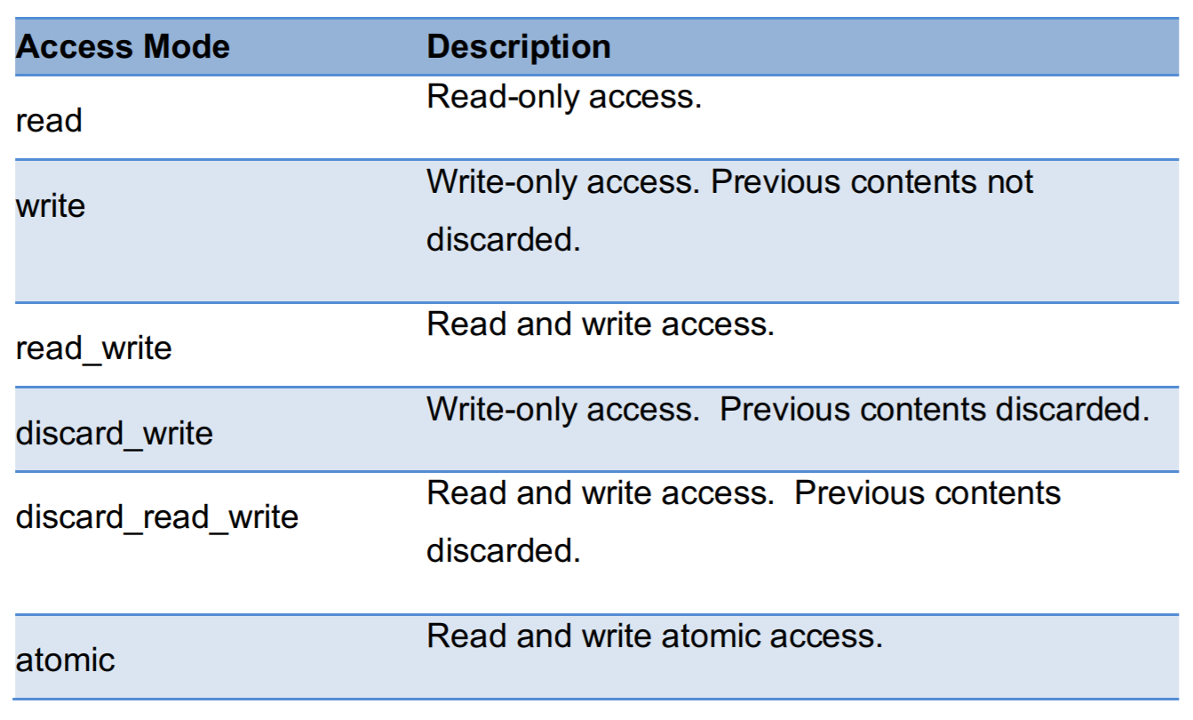
Buffers
buffer<Type, dims> class is generic over the element type and the number of dimensions(1D, 2D, or 3D).
Buffers may not be directly accessed by the host and device.
Create accessors in order to read and write buffers.
Access modes are defined in the sycl::access::mode enum described below:
Notes:
The buffer<Type, dims> class is generic over the element type and the number of dimensions, which can be one, two or three.
To use buffer, the simplest method is to simply construct a new buffer object only passing a range that specifies the size of the buffer. However, creating a buffer in this way does not initialize its data. Buffers may not be directly accessed by the host and device. Instead, we must create accessors in order to read and write buffers. The accessor class is heavily templated, so we typically do not directly create accessor objects. Instead, we use helper methods contained in the buffer class: get_access(). When creating an accessor, we must inform the runtime how we are going to use it. We do this by specifying an access mode. Access modes are defined in the table:

Slide 27
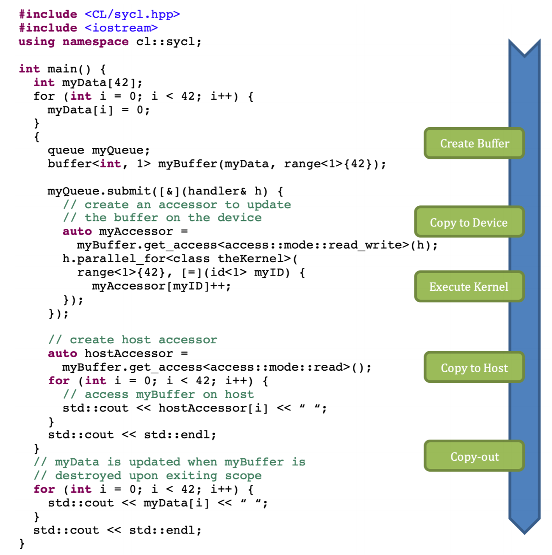
Example
The accessor myAccessor is created with access::mode::read_write.
This lets the runtime know that we intend to both read and write to the buffer through myAccessor.
Notes:
In the code example shown in below, the accessor myAccessor is created with access::mode::read_write. This lets the runtime know that we intend to both read and write to the buffer through myAccessor.

Slide 28
Ordering the Uses of Data
First, we can synchronize through the host by explicitly calling the wait() method on the event.
Explicitly waiting on events can be very useful for debugging an application
Wait() can overly constrain the asynchronous execution of tasks since it halts all execution on the host thread.
Second, we can use method named depends_on().
This method accepts either a single event or a vector of events and informs the runtime that the command group being submitted requires the specified events to complete before the specified task may execute.
Notes:
In DPC++, kernels can be viewed as asynchronous tasks that are submitted for execution. In many cases, kernels must execute in a specific order so that the correct result is computed. If obtaining the correct result requires task A to execute before task B, we say that a dependence exists between tasks A and B.
In DPC++, we can express these dependences through event objects. First, we can synchronize through the host by explicitly calling the wait() method on the event. This forces the runtime to wait for the task that generated the event to finish executing before host program execution may continue.
The second way is to use method named depends_on(). This method accepts either a single event or a vector of events and informs the runtime that the command group being submitted requires the specified events to complete before the specified task may execute.

Slide 29
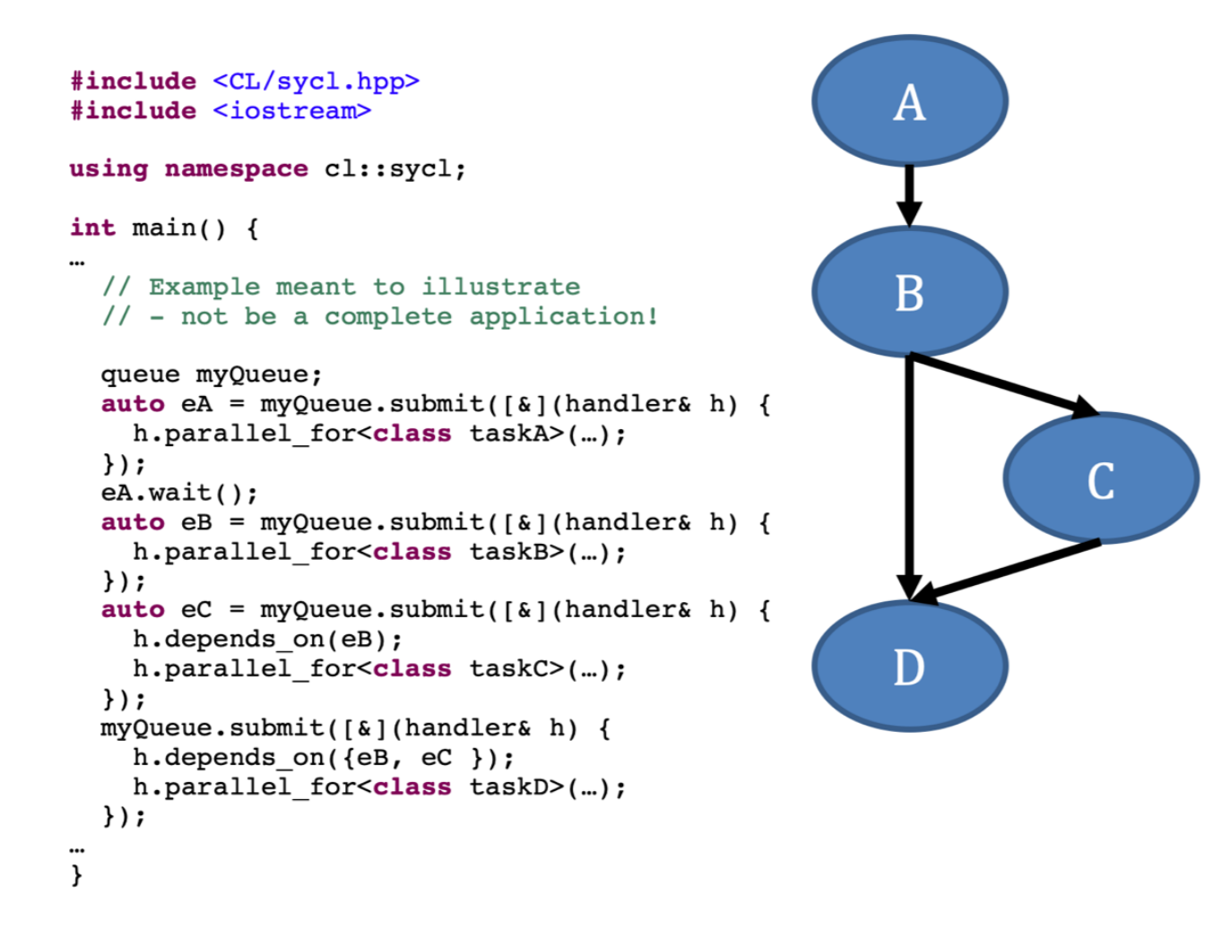
Example of depends_on()
Notes:
Figure below shows an example of how depends_on() may be used to order tasks.

Slide 30
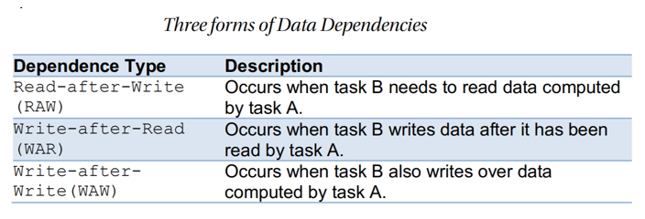
Implicit dependences
Implicit dependences between tasks in DPC++ are created from data dependences as shown below:
Notes:
Implicit dependences between tasks in DPC++ are created from data dependences as shown below:

Slide 31
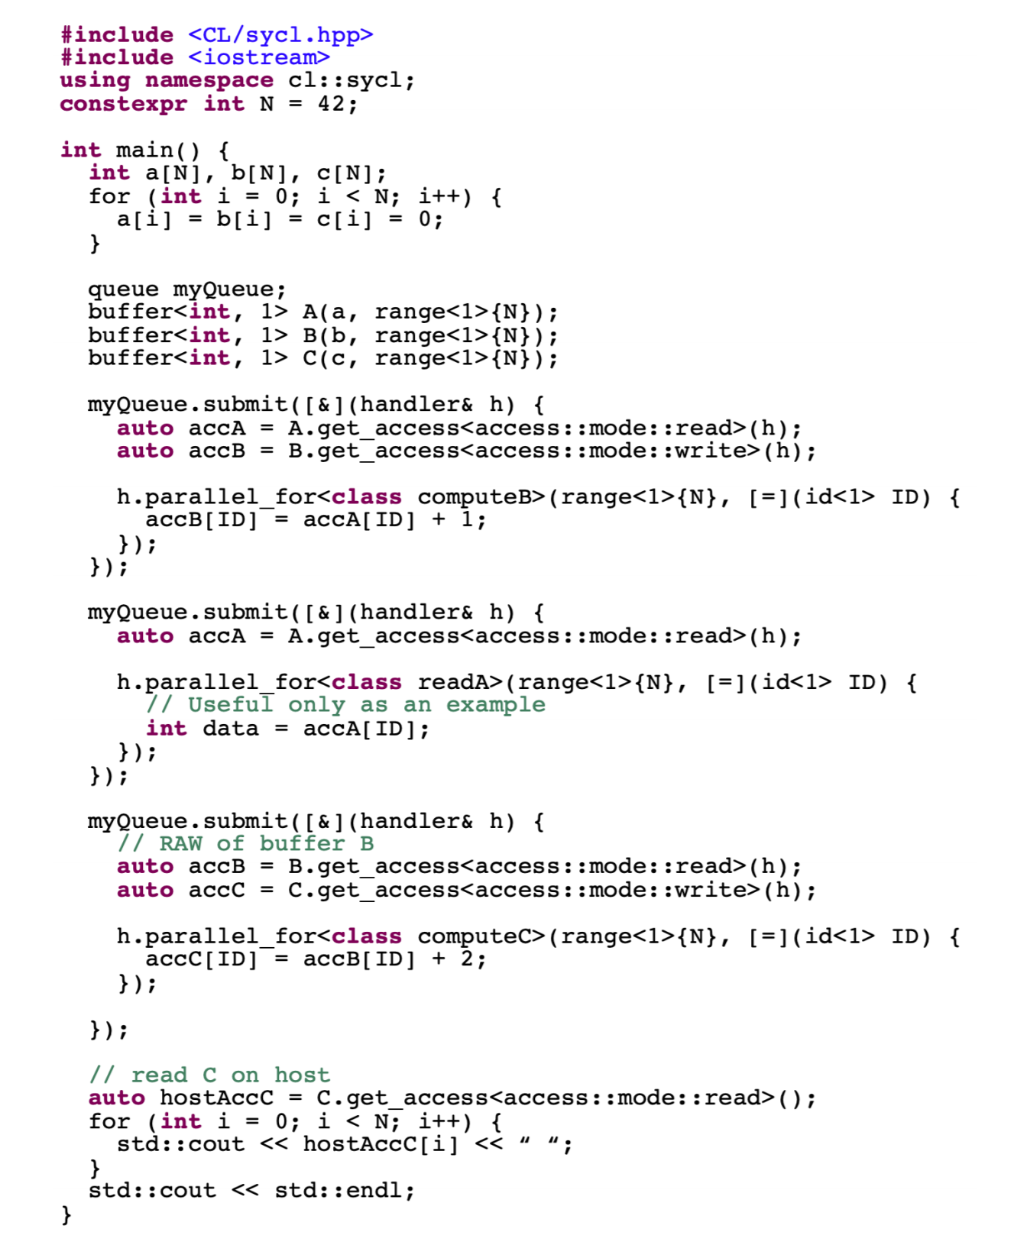
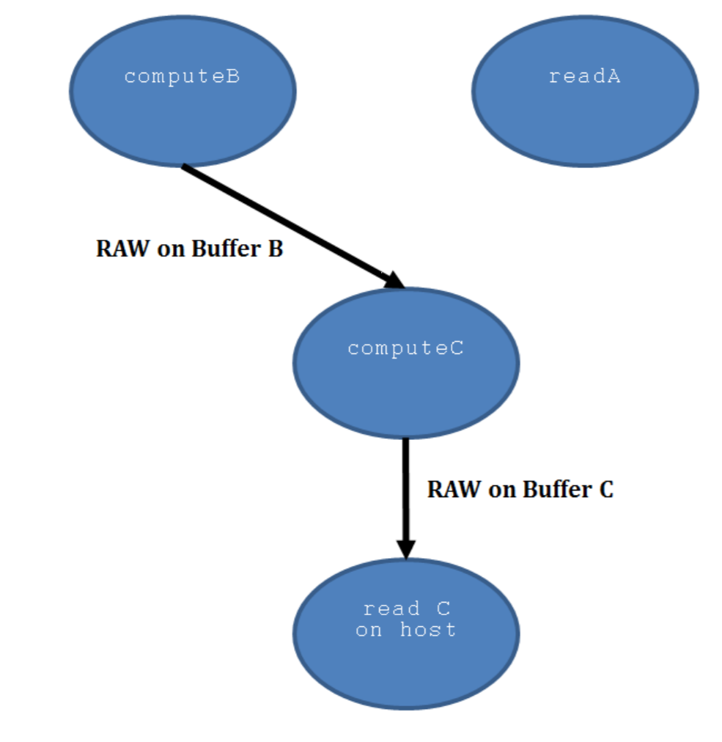
Example
Notes:
In Figures below, we execute three kernels: computeB, readA, and computeC, then read the final result back on the host.
The first decision to make is whether you want to use explicit or implicit data movement since this greatly affects what needs to be done to bring a program into DPC++. Implicit data movement is generally an easier place to start because DPC++ will handle all the data movement, letting you focus on expressing the computation

Slide 32
Expressing Parallelism
Parallelism within Kernels
Basic Data Parallel Kernels
ND-Range Kernels
Hierarchical Data Parallel Kernels
Choosing a kernel form
Notes:
We have already covered how to control where code runs (on what device), and how to get data to our code (accessible from a particular device). Now, we introduce the concept of a data parallel kernel.

Slide 33
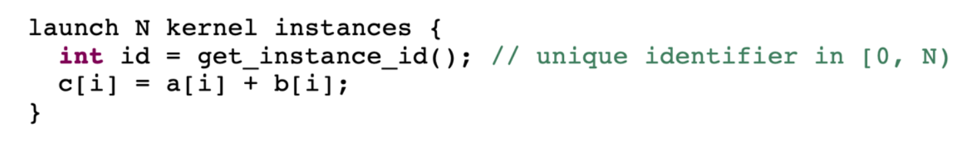
Parallelism within Kernels
Kernels describe parallelism in terms of abstract concepts that an implementation (i.e. a combination of compiler and runtime) can then map to the hardware parallelism available on a particular target device.
A parallel kernel is not a loop, and does not have iterations as shown below.
A kernel describes a single operation, which can be instantiated many times and applied to different input data;
When a kernel is launched in parallel, multiple instances of that operation are executed simultaneously.
Notes:
Kernels describe parallelism in terms of abstract concepts that an implementation (i.e. a combination of compiler and runtime) can then map to the hardware parallelism available on a particular target device. It ensures that applications can scale up (or down) to fit the capabilities of different platforms.
A parallel kernel is not a loop, and does not have iterations as shown below. Rather, a kernel describes a single operation, which can be instantiated many times and applied to different input data; when a kernel is launched in parallel, multiple instances of that operation are executed simultaneously.

Slide 34
Different Kernel Forms in DPC++
Basic Data Parallel Kernels
The first kernel form is used for basic data parallel kernels.
ND-range (N-dimensional range)
The second kernel form extends basic kernels to provide access to low-level performance-tuning features. This second form is known as
Hierarchical Data Parallel Kernels
The third form is referred to as hierarchical data parallel, referring to the hierarchy of the nested kernel constructs that appear in source code.
Notes:
DPC++ provides three different kernel forms, each with their own execution models and syntax. The first kernel form is used for basic data parallel kernels. The second kernel form extends basic kernels to provide access to low-level performance-tuning features. This second form is known as ND-range (N-dimensional range). The third form is referred to as hierarchical data parallel, referring to the hierarchy of the nested kernel constructs that appear in source code.

Slide 35
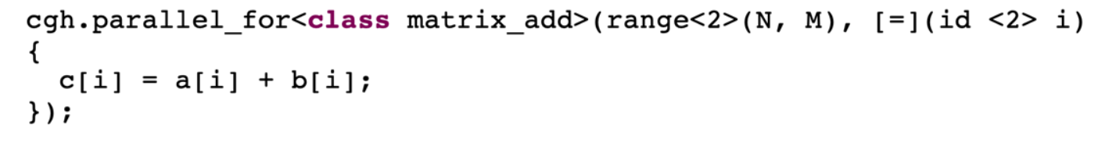
Basic Data Parallel Kernels
The most basic form of parallel kernel in DPC++ is appropriate for operations that can be applied to every piece of data completely independently and in any order (embarrassingly parallel).
Basic data parallel kernels are expressed using the parallel_for function, which is a member of the handler class and can only be called at command-group scope.
The function only takes two arguments: the first is a range specifying the number of items to launch in each dimension; and the second is a kernel function to be executed for each index in the range. The kernel can take either an id or an item as its argument.
Notes:
The most basic form of parallel kernel in DPC++ is appropriate for operations that can be applied to every piece of data completely independently and in any order.
Basic data parallel kernels are expressed using the parallel_for function,
The function only takes two arguments: the first is a range specifying the number of items to launch in each dimension; and the second is a kernel function to be executed for each index in the range. The kernel can take either an id or an item as its argument.

Slide 36
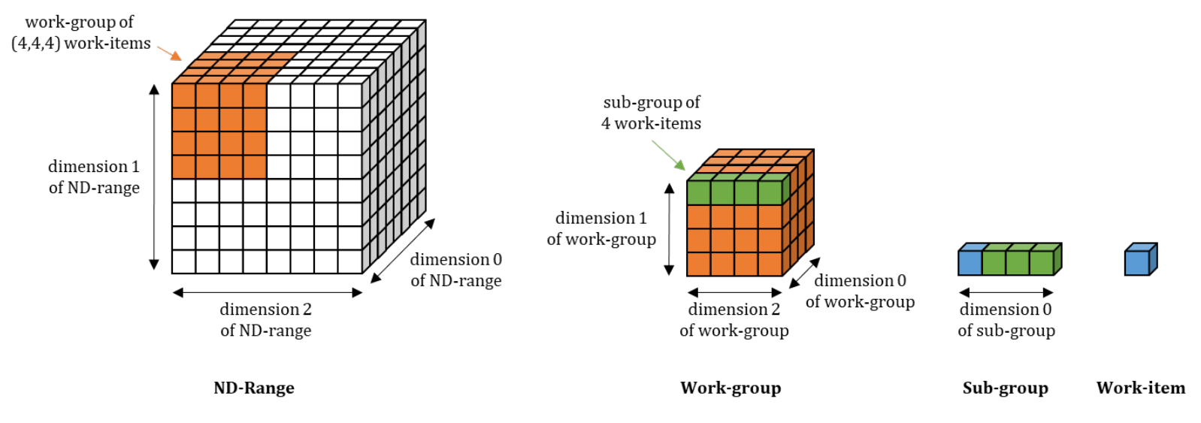
ND-Range Kernels
The key difference is that each program instance can query its position within the groups that contain it, and can access additional functionality specific to each type of group.
The execution range of an ND-range kernel is divided into
work-groups
sub-groups
work-items (as shown below).
The ND-range represents the total execution range, which is divided into work-groups of uniform size. Each work-group can be further divided by the implementation into sub-groups.
Notes:
Like basic data parallel kernels, ND-range kernels are written in a SPMD style where all work-items execute the same kernel "program" applied to multiple pieces of data.
The key difference is that each program instance can query its position within the groups that contain it, and can access additional functionality specific to each type of group.
Work-items represent the individual instances of a kernel function.
The work-items in an ND-range are organized into work-groups. Work-groups can execute in any order, and work-items in different work-groups cannot communicate or synchronize with each other except by way of atomic memory operations to global memory.

Slide 37
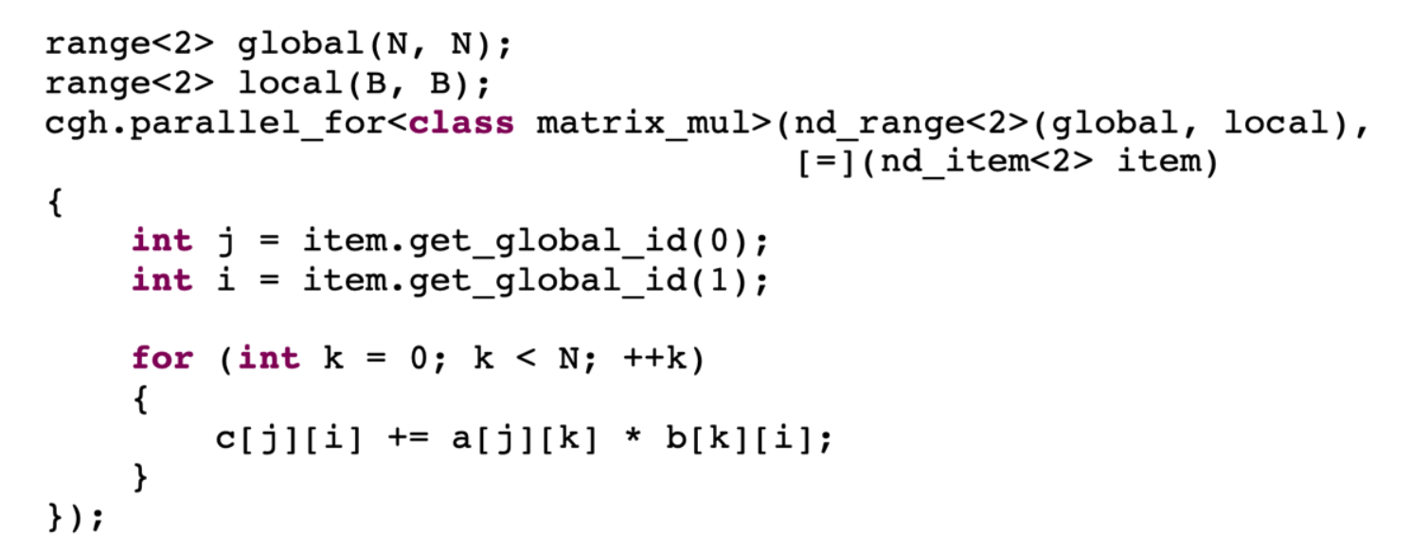
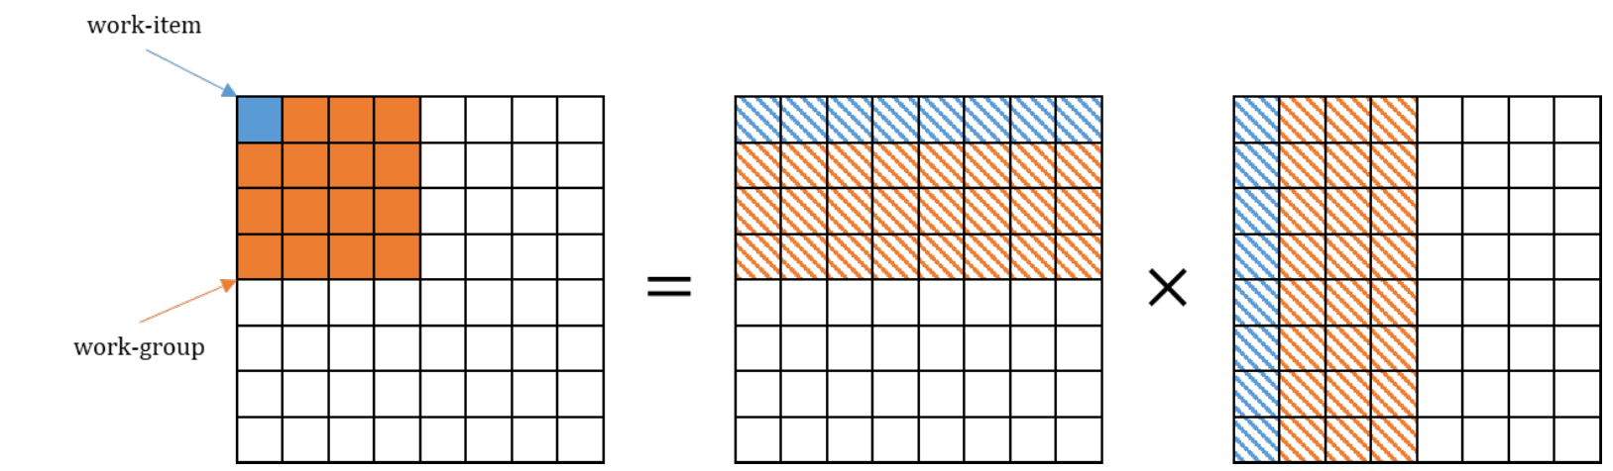
Example
Implements the matrix multiplication kernel using the ND-range parallel kernel
Notes:
diagram below shows how the work in this kernel is mapped to the work-items in each work-group. Grouping our work-items in this way ensures locality of access and hopefully improves cache hit rates: for example, the work-group has a local range of (4, 4) and contains 16 work-items, but only accesses four times as much data as a single work-item — in other words, each value we load from memory can be re-used four times.

Slide 38
Hierarchical Data Parallel Kernels
Hierarchical data parallel kernels offer an experimental alternative syntax for expressing kernels in terms of work-groups and work-items, where each level of the hierarchy is programmed using a nested invocation of the parallel_for function.
In hierarchical kernels, the parallel_for function is replaced by the parallel_for_work_group and parallel_for_work_item functions, which correspond to work-group and work-item parallelism respectively.
At the time of writing, there is no access to sub-groups within hierarchical kernels.
Notes:
Hierarchical data parallel kernels offer an experimental alternative syntax for expressing kernels in terms of work-groups and work-items, where each level of the hierarchy is programmed using a nested invocation of the parallel_for function. One complexity of hierarchical kernels is that each nested invocation of parallel_for creates a separate SPMD context; each scope defines a new "program" that should be executed by all parallel workers associated with that scope. Mapping nested parallelism to accelerators is a challenge that is not unique to DPC++.

Slide 39
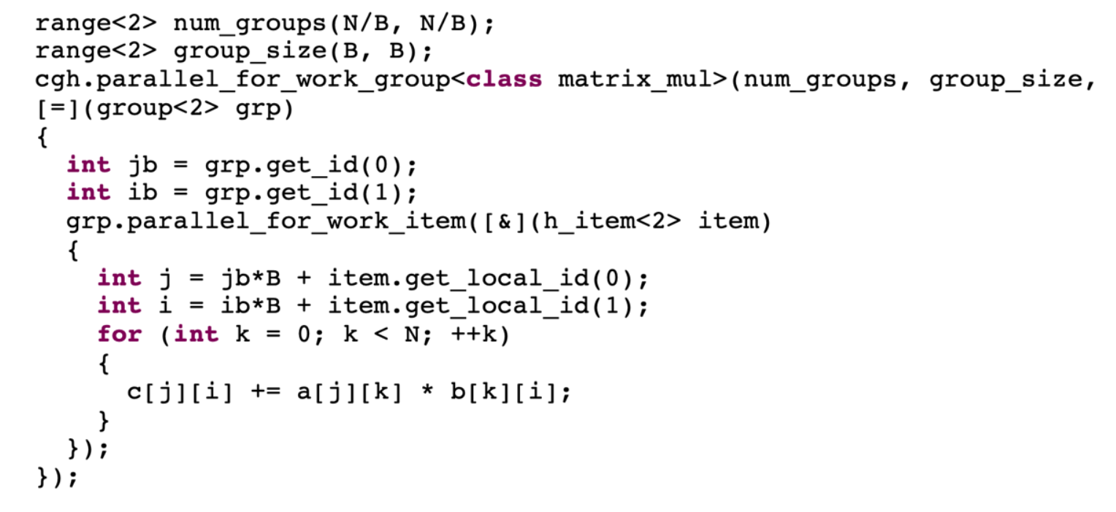
Example
Notes:
As shown in below, kernels expressed using hierarchical parallelism are very similar to ND-range kernels. We should therefore view hierarchical parallelism primarily as a productivity feature; it doesn't expose any functionality that isn't already exposed via ND-range kernels, but it may improve the readability of our code and/or reduce the amount of code that we have to write.

Slide 40
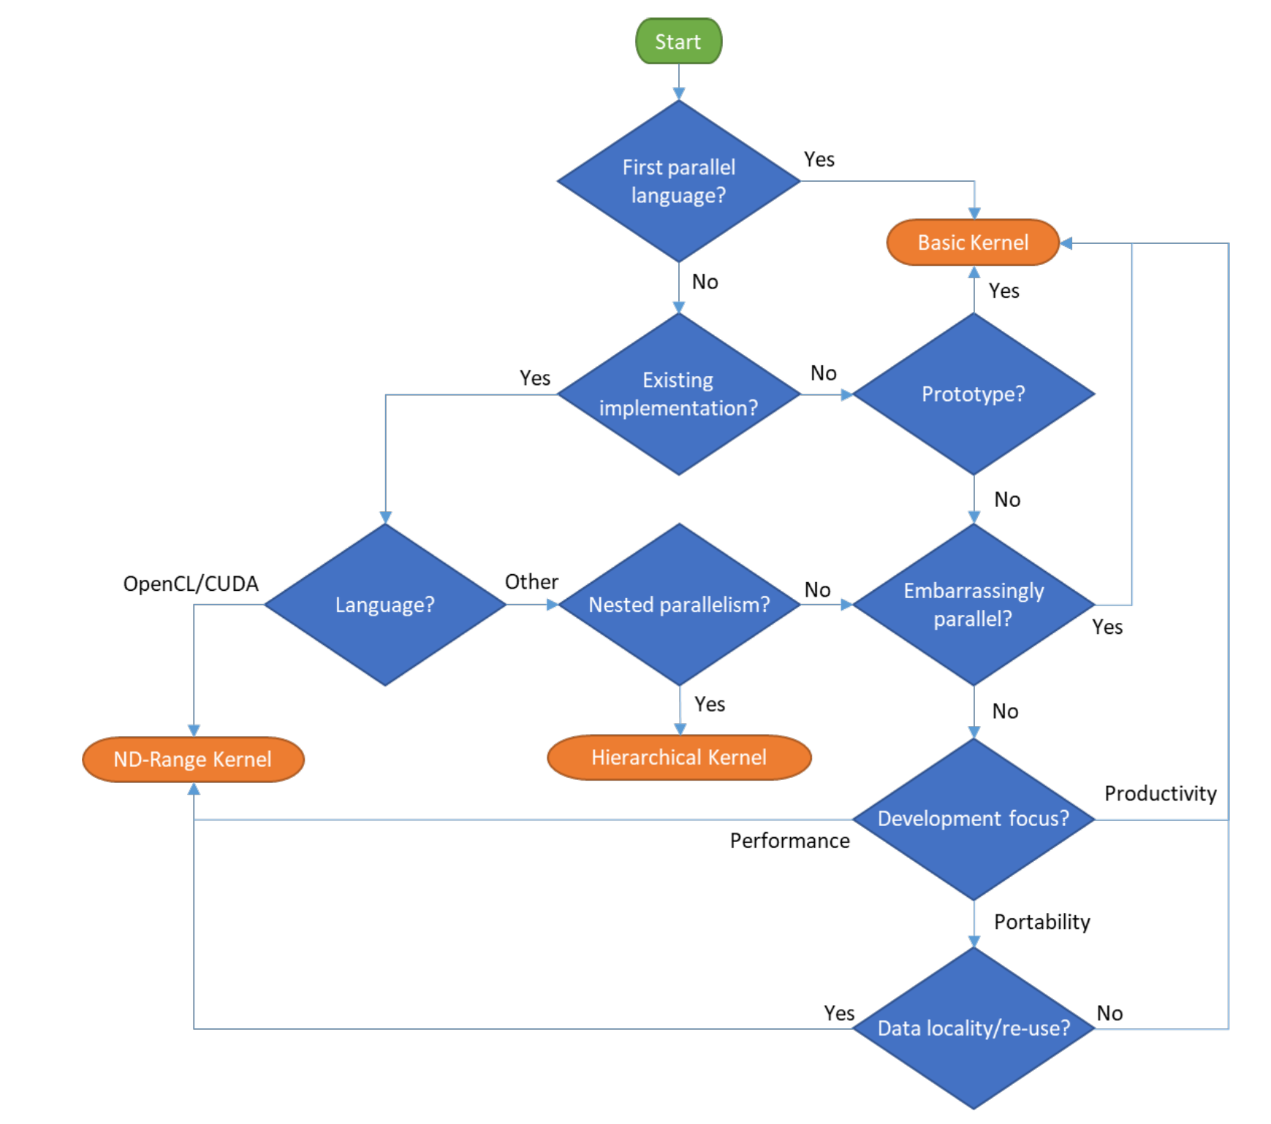
Choosing a kernel form
Notes:
Choosing between the different kernel forms is largely a matter of personal preference. However, the rule of thumb is the flowchart below, which selects a kernel form based on:
1. Whether you have previous experience with parallel programming.
2. Whether you are writing a new code from scratch, or are porting an existing parallel program written in a different language.
3. Whether your kernel is embarrassingly parallel, already contains nested parallelism, or re-uses data between different instances of the kernel function.
4. Whether you are writing a new kernel in SYCL to maximize performance, to improve the portability of your code, or because it provides a more productive means of expressing parallelism than lower-level languages.

Slide 41
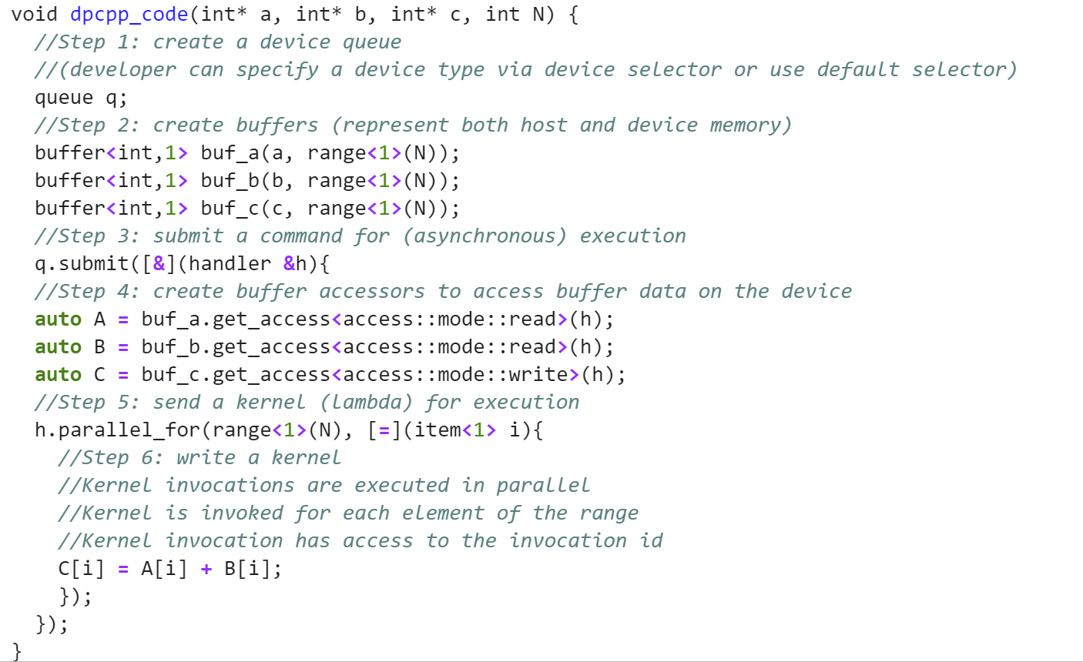
Simple Vector addition using DPC++
Notes:
Now lets look at a simple vector addition in DPC++

Slide 42
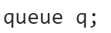
Step 1 in a DPC++ Program
1) Create a device queue.
Offload computation to a device by submitting tasks to a queue.
The programmer can choose CPU, GPU, FPGA, and other devices through the selector.
Default q
Means DPC++ runtime selects the most capable device available at runtime by using the default selector.
Notes:
At the beginning, we should create a queue. We do not selected any specific device, therefore it will run on host CPU.

Slide 43
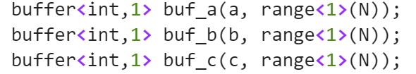
Step 2 in a DPC++ Program
2) Create buffers
Device and host can either share physical memory or have distinct memories.
If memories are distinct, offloading computation requires copying data between host and device.
By creating Buffers and Accessors, DPC++ ensures that the data is available to host and device without any programmer effort.
DPC++ also allows the programmer explicit control over data movement when it is necessary to achieve best peformance.
Notes:
After that, we should create buffers for data management between the accelerator and host

Slide 44
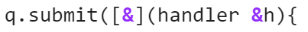
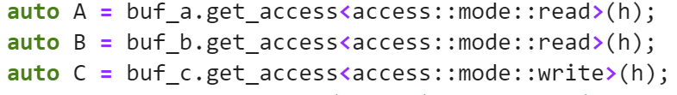
Step 3 & 4 in a DPC++ Program
3)Submit a command for (asynchronous) execution
4) Create buffer accessor to access buffer data on the device
Notes:
We must submit the queue. Then In order to use the buffers, we require to define accessors as follow:

Slide 45
Step 5 in a DPC++ Program
5) Define a kernel, which is applied to every point in an index space.
In simple programs: the index space maps directly to the elements of the array.
The kernel is encapsulated in a C++ lambda function.
The lambda function is passed a point in the index space as an array of coordinates.
The parallel_for in the below program applies the lambda to the index space. The index space is defined in the first argument of the parallel_for as a 1 dimensional range from 0 to N-1.
Notes:
The we use a dispatch function parallel_for

Slide 46
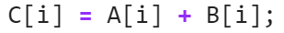
Step 6 in a DPC++ Program
6) Write a kernel
Kernel invocation are executed in parallel
Kernel is invoked for each element of the range
Kernel invocation has access to the invocation id
Notes:
Inside parallel for kernel, we put the computation and it will be executed on the accelerator device.

Slide 47
Thank you

